Slide 1
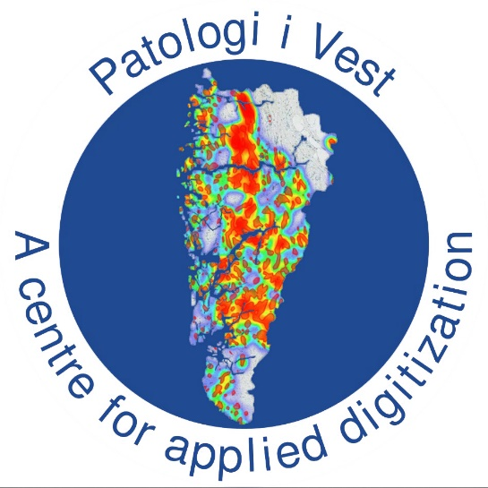
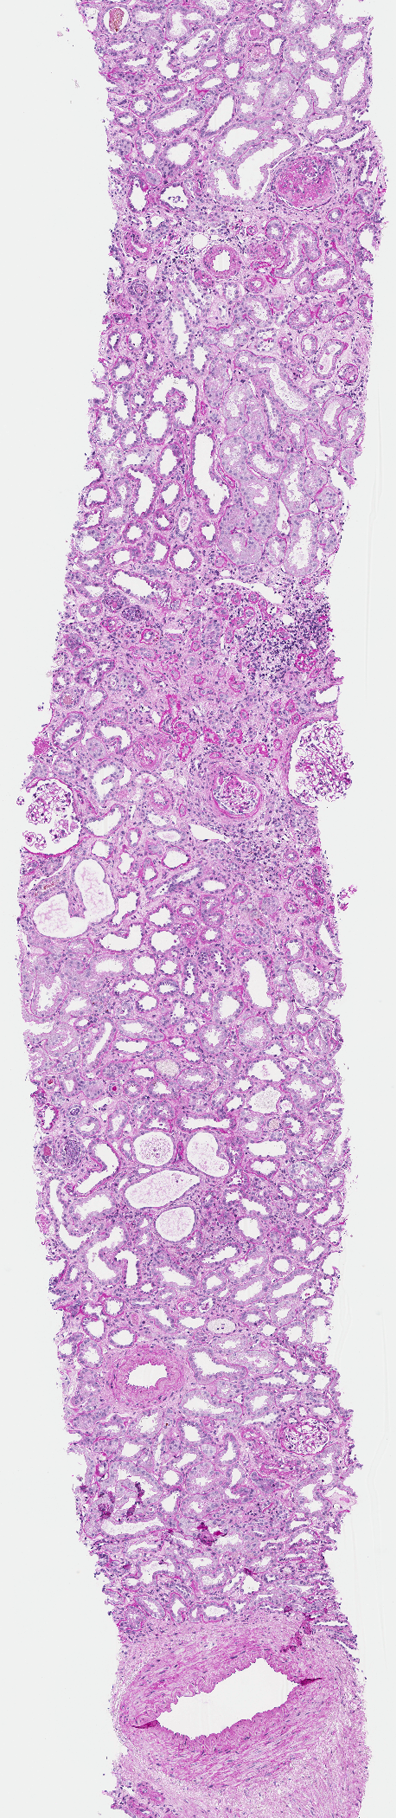
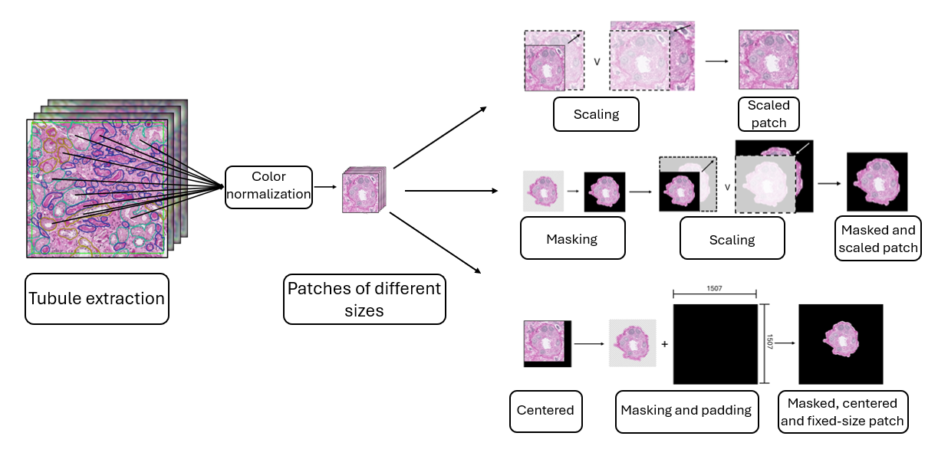
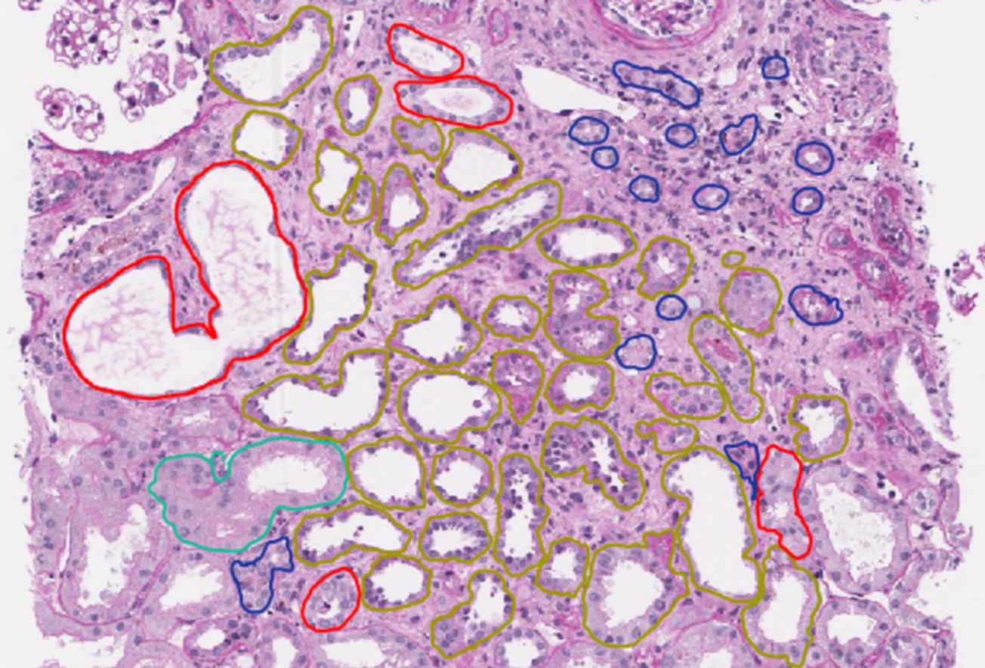
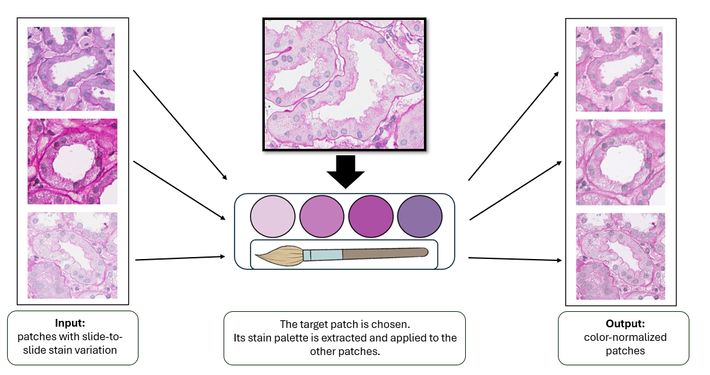
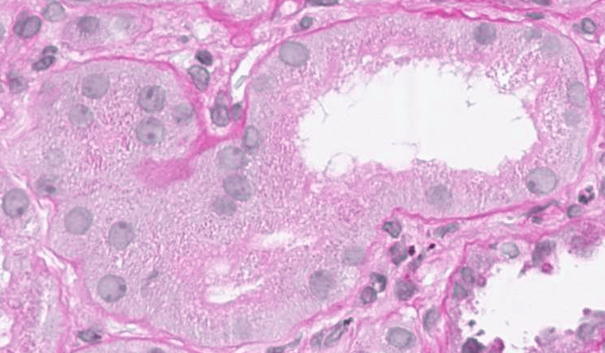
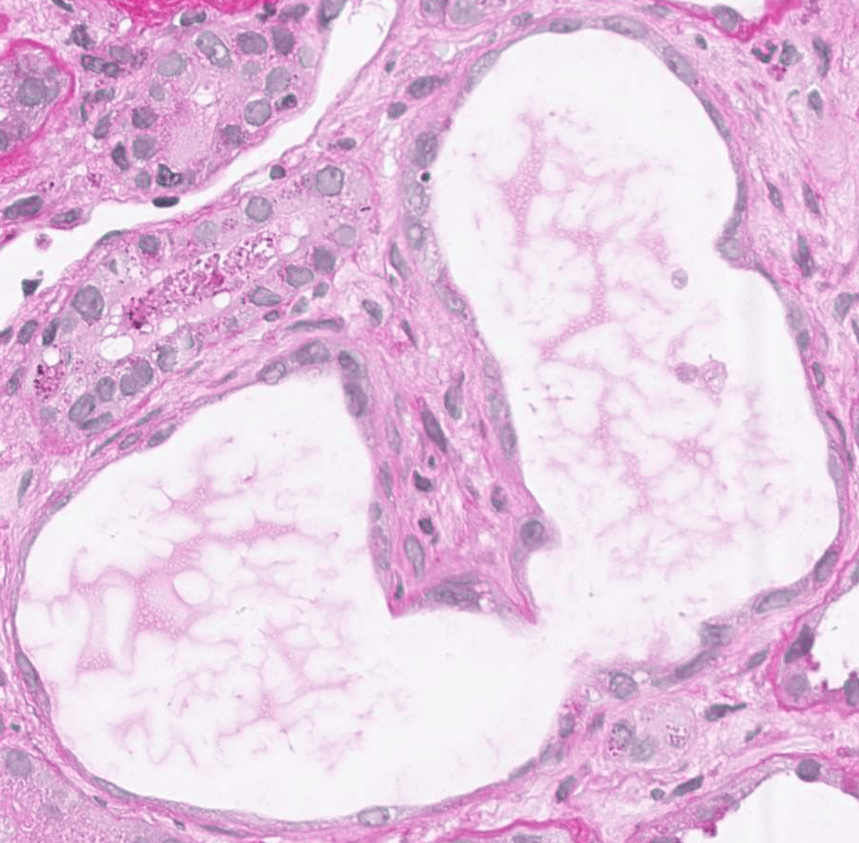
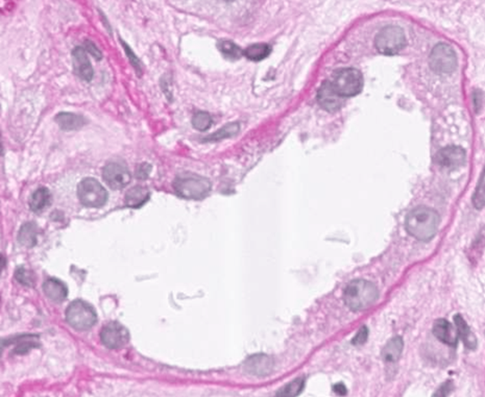
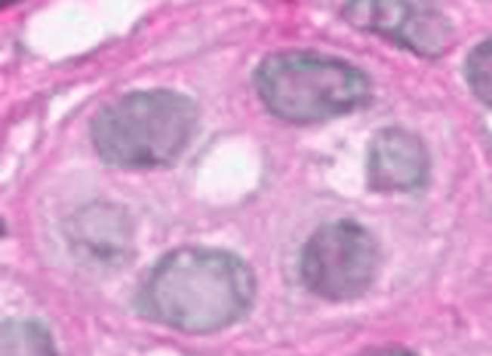
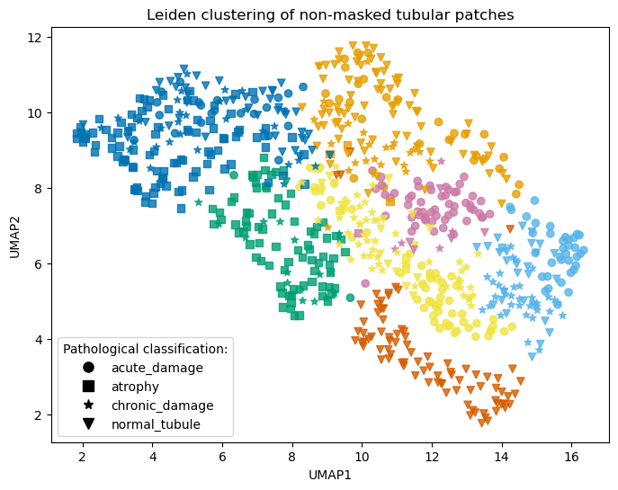
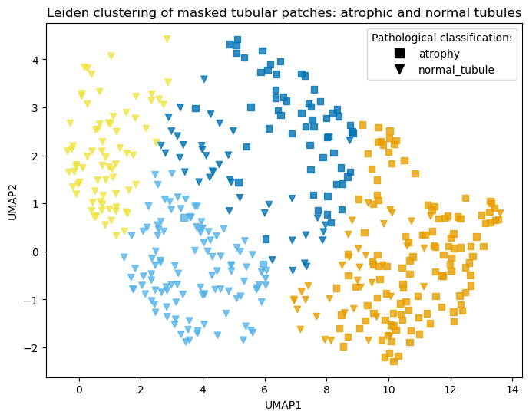


Unsupervised clustering of tubules in kidney biopsy images
Anne Mari S. Gjøn¹, Martine Olset¹, Borghild T. Larsen², Sabine Leh^{2,3}, Hrafn Weishaupt²
¹University of Bergen, Bergen, Norway
²Department of Pathology, Haukeland University Hospital, Bergen, Norway
³Department of Clinical Medicine, University of Bergen, Bergen, Norway
SUMMARY
TUBULAR EXTRACTION
Background: Chronic kidney disease (CKD) affects about 10% of people globally and can lead to kidney failure, potentially necessitating replacement therapy. Pathologists diagnose CKD by identifying lesions in kidney tissue and assessing structural changes relative to normal kidney morphologies. Specifically in digital nephropathology, whole-slide images (WSIs) of kidney biopsies enable machine learning to support diagnostic and prognostic assessments. Detecting abnormalities in tubules is essential for accurate diagnosis, yet tubular lesions are less studied than other kidney structures. To close this gap, this project aims to develop a beneficial clustering strategy for labelling tubular lesions. This will help lay the groundwork for an AI tool to assist pathologists with tubular-lesion labelling and review.
WORKFLOW
A
Normal tubule
B
Aqutely damaged
C
Chronically damaged
Fig. … How tubules are extracted as individual patches from whole-slide images and then divided into three distinct datasets.
D
Atrophic tubule
STAIN NORMALISATION
Fig.1: A whole-slide image (WSI) with annotated tubules, classified as normal, chronically damaged, acutely damaged, and atrophic. These tubular annotations are then extracted into individual tubular patches.
Methodes: The dataset consists of 809 labelled tubular annotations classified as normal, chronically damaged, acutely damaged, or atrophic. Tubules classified as normal are considered healthy, whereas all remaining categories are regarded as lesioned. First, tubules are extracted from WSIs using three distinct approaches. This produces three datasets: (1) scaled patches, (2) masked and scaled patches, and (3) masked and centred patches, retaining the relative tubule size. Next, the datasets are analysed using different clustering strategies. The dataset type that works best is undetermined, so a key objective is to compare their performances. Finally, the clustering outcomes will be evaluated to determine whether they correspond to pathological classification.
Patches come from different histology slides, causing stain variation that can confuse the model. To reduce this variation, we select a patch with mid-level staining as the target. A stain palette is then extracted from this target patch and applied to the other patches, yielding color-normalized patches.
TUBULAR CLASSES
A
B
C
D
Fig... Examples of tubular structures from stained WSI
A: Normal tubule
B: Aqutely damaged
C: Chronically damaged
D: Atrophic tubule
Fig…… Illustration of the stain-normalization process
CLUSTERING OUTCOMES:
Fig. … Results from Leiden clustering on the non-masked dataset. This results indicate that the clustering can distinguish atrophic tubules from other classes, and is also capable of separating normal tubules from lesioned tubules. Additional subgroup structures also appear to emerge.
Fig. … Results from Leiden clustering on the masked tubular dataset, where only atrophic and normal tubules are included. The clustering effectively separates atrophic from normal tubules, and additional subgroup structures appear to emerge, such as potential subclasses within the normal tubules.
REFERENCES????
DISCUSSION
Preliminary results: So far, the Leiden clustering strategy appears to provide the most effective clustering results, and UMAP seems to be the best dimensional reduction for visualization. The different datasets yield varying cluster structures, but overall, their performance seems comparable. Additional clustering strategies and alternative models remain to be explored. Overall, these preliminary results indicate that the clustering is able to distinguish atrophic and normal tubules from other types, which is both promising and interesting.

